Slide 1

Management
15th Edition, Global Edition
Capítulo 2
Tomada de decisão
Copyright © 2018 Pearson Education, Ltd. All Rights Reserved

Slide 2
Objetivos
2.1 Descrever as oito etapas do processo de tomada de decisão.
2.2 Explicar os diferentes modos como os gestores tomam decisões.
2.3 Tipificar as decisões e as condições de tomada de decisão.
2.4 Descrever como os enviesamentos podem afetar o processo de tomada de decisão.
2.5 Identificar técnicas eficazes de tomada de decisão.

Slide 3
Seja um Melhor Decisor
Uma chave do sucesso na gestão e na carreira é saber como se tomam decisões eficazes.

Slide 4
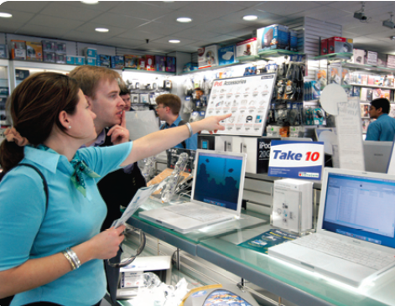
Decisão?
Uma escolha entre duas ou mais alternativas.
Notes:
Managers at all levels and in all areas of organizations make decisions. That is, they make choices. Although decision-making is typically described as choosing among alternatives, this view is too simplistic. Why? Because decision-making is (and should be) a process, not just a simple act of choosing among alternatives.
Source: Alex Segre/Alamy

Slide 5
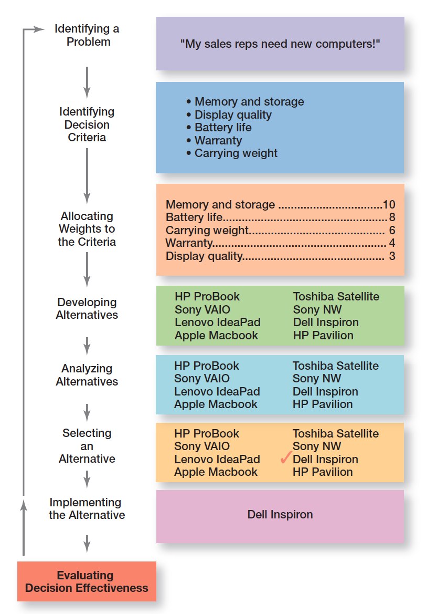
O Processo de tomada de decisão
Exhibit 2.1 shows the eight steps in the decision-making process. This process is as relevant to personal decisions as it is to corporate decisions.

Slide 6
Processo de tomada de decisão
Etapa 1: Identificar o Problema
  Problema: um obstáculo que dificulta a obtenção de um resultado desejado
  Todas as decisões começam com um problema, uma discrepância entre as condições desejadas e as existentes.
  Exemplo: A Joana é uma gestora de vendas e os seus vendedores precisam de novos portáteis.
Notes:
Every decision starts with a problem, a discrepancy between an existing and a desired condition. For our example, Amanda is a sales manager whose reps need new laptops because their old ones are outdated and inadequate for doing their job. To make it simple, assume it’s not economical to add memory to the old computers and it’s the company’s policy to purchase, not lease. Now we have a problem—a disparity between the sales reps’ current computers (existing condition) and their need to have more efficient ones (desired condition). Amanda has a decision to make.

Slide 7
Processo de tomada de decisão
Etapa 2: Identificar os Critérios de Decisão
- Critérios de decisão: são fatores que são importantes (relevantes) para resolver o problema.
Exemplo: A Joana decide que a memória e capacidade de armazenamento, a qualidade do ecrã, a duração da bateria, garantia e o peso são os critérios relevantes para a sua decisão.
Notes:
Once a manager has identified a problem, he or she must identify the decision criteria important or relevant to resolving
the problem. Every decision-maker has criteria guiding his or her decisions even if they’re not explicitly stated. In our example,
Amanda decides after careful consideration that memory and storage capabilities, display quality, battery life, warranty, and carrying weight are the relevant criteria in her decision.

Slide 8
Processo de tomada de decisão
Etapa 3: Atribuir uma ponderação para cada um dos critérios
Se os critérios relevantes não são igualmente importantes, o decisor deve atribuir um peso diferenciado para cada critério. Um peso que permita acomodar essas diferentes prioridades, na tomada de decisão.
Os critérios ponderados para o nosso exemplo são mostrados na Figura 2-2.
Notes:
If the relevant criteria aren’t equally important, the decision maker must weight the items in order to give them the correct
priority in the decision. How? A simple way is to give the most important criterion a weight of 10 and then assign weights to the rest using that standard. Of course, you could use any number as the highest weight. The weighted criteria for our example is shown in Exhibit 2-2.

Slide 9
Critérios de decisão relevantes
Criterion | Weight
Memory and storage | 10
Battery life | 8
Carrying weight | 6
Warranty | 4
Display quality | 3

Slide 10
Processo de tomada de decisão
Etapa 4: Desenvolver as Alternativas
  Listar alternativas viáveis ​​que poderiam resolver o problema.
  Exemplo: A Joana, identificou oito portáteis como possíveis escolhas. (Vide Figura 2-3).
Notes:
The fourth step in the decision-making process requires the decision maker to list viable alternatives that could resolve the problem. In this step, a decision maker needs to be creative, and the alternatives are only listed—not evaluated—just yet. Our sales manager, Amanda, identifies eight laptops as possible choices (see Exhibit 2-3).

Slide 11
Processo de tomada de decisão
Etapa 5: Análise das Alternativas
  Avaliar os pontos fortes e fracos de cada alternativa.
  A avaliação de uma alternativa é baseada na sua capacidade de resolver os problemas relacionados com os critérios e a sua importância relativa (ponderadores).
Notes:
The fourth step in the decision-making process requires the decision maker to list viable alternatives that could resolve the problem. In this step, a decision maker needs to be creative, and the alternatives are only listed—not evaluated—just yet. Our sales manager, Amanda, identifies eight laptops as possible choices (see Exhibit 2-3).

Slide 12
Alternativas
Laptop | Memory and Storage | Battery Life | Carrying Weight | Warranty | Display Quality
HP ProBook | 10 | 3 | 10 | 8 | 5
Lenovo IdeaPad | 8 | 5 | 7 | 10 | 10
Apple MacBook | 8 | 7 | 7 | 8 | 7
Toshiba Satellite | 7 | 8 | 7 | 8 | 7
Apple MacBook Air | 8 | 3 | 6 | 10 | 8
Dell Inspirion | 10 | 7 | 8 | 6 | 7
HP Pavilion | 4 | 10 | 4 | 8 | 10

Slide 13
Processo de tomada de decisão
Etapa 6: Seleção da melhor Alternativa
É escolhida a alternativa que maior resultado esperado apresente, na satisfação de todos de todos os critérios, devidamente ponderados pela sua importância relativa.
Notes:
The sixth step in the decision-making process is choosing the best alternative or the one that generated the highest total in Step 5. In our example (Exhibit 2-4), Amanda would choose the Dell Inspiron because it scored higher than all other alternatives (249 total).

Slide 14
Avaliação das Alternativas
Laptop | Memory and Storage | Battery Life | Carrying Weight | Warranty | Display Quality | Total
HP ProBook | 100 | 24 | 60 | 32 | 15 | 231
Lenovo IdeaPad | 80 | 40 | 42 | 40 | 30 | 232
Apple MacBook | 80 | 56 | 42 | 32 | 21 | 231
Toshiba Satellite | 70 | 64 | 42 | 32 | 21 | 229
Apple MacBook Air | 80 | 24 | 36 | 40 | 24 | 204
Dell Inspirion | 100 | 56 | 48 | 24 | 21 | 249
HP Pavilion | 40 | 80 | 24 | 32 | 30 | 206

Slide 15
Processo de tomada de decisão
Etapa 7: Implementar a melhor Alternativa
  - Colocar em ação a melhor alternativa.
  - Comunicando a decisão e ganhando o compromisso de quem a irá implementar.
Notes:
In Step 7 in the decision-making process, you put the decision into action by conveying it to those affected and getting their commitment to it. We know that if the people who must implement a decision participate in the process, they’re more likely to support it than if you just tell them what to do. Another thing managers may need to do during implementation is reassess the environment for any changes, especially if it’s a long-term decision. Are the criteria, alternatives, and choice still the best ones, or has the environment changed in such a way that we need to reevaluate?

Slide 16
Processo de tomada de decisão
Etapa 8: Avaliação da eficácia da decisão
A eficácia da decisão é julgada pelos seus resultados.
  Qual o nível de resolução do problema, resultante da implementação da(s) alternativa(s) escolhida(s)?
  - Se o problema não foi resolvido, o que é que correu mal?
Notes:
The last step in the decision-making process involves evaluating the outcome or result of the decision to see whether the problem was resolved. If the evaluation shows that the problem still exists, then the manager needs to assess what went wrong. Was the problem incorrectly defined? Were errors made when evaluating alternatives? Was the right alternative selected but poorly implemented? The answers might lead you to redo an earlier step or might even require starting the whole process over.

Slide 17
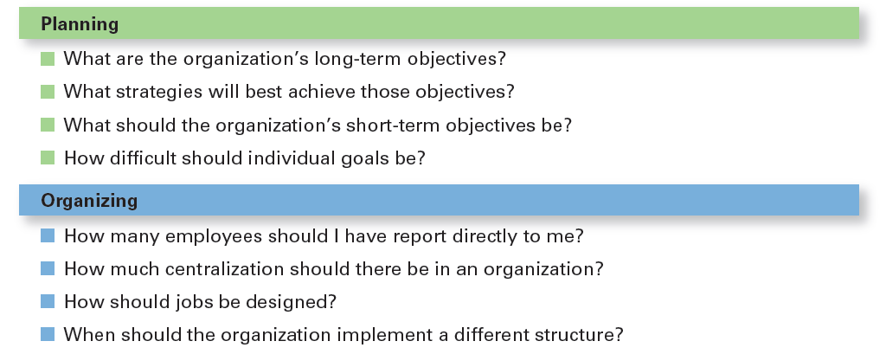
Exemplo de decisões de gestão: Planeamento e Organização
Notes:
Although everyone in an organization makes decisions, decision-making is particularly important to managers. As Exhibit 2-5 shows, it’s part of all four managerial functions. In fact, that’s why we say that decision-making is the essence of management. And that’s why managers—when they plan, organize, lead, and control—are called decision makers.

Slide 18
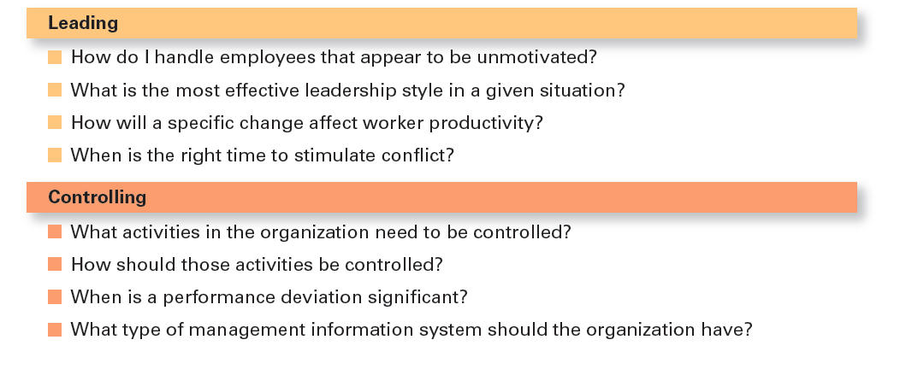
Exemplo de decisões de gestão: Liderança e Controlo

Slide 19
Modos de tomada de decisão: A Racionalidade
Racionalidade: decisões que são lógicas e consistentes e que maximizam o valor
Pressupostos da racionalidade
  O decisor é lógico e objetivo
  O problema é claro e sem ambiguidade
  O decisor tem um objetivo claro e específico e conhece todas as alternativas e suas consequências
  O decisor escolhe a alternative que maximiza o seu objetivo
  As decisões são tomadas tendo em conta os interesses da organização
Notes:
We assume that managers will use rational decision-making; that is, they’ll make logical and consistent choices to maximize value. After all, managers have all sorts of tools and techniques to help them be rational decision makers. Managers aren’t always rational. What does it mean to be a “rational” decision maker? A rational decision maker would be fully objective and logical. The problem faced would be clear and unambiguous, and the decision maker would have a clear and specific goal and know all possible alternatives and consequences. Finally, making decisions rationally would consistently lead to selecting the alternative that maximizes the likelihood of achieving that goal.
These assumptions apply to any decision—personal or managerial. However, for managerial decision making, we need to add one additional assumption—decisions are made in the best interests of the organization. These assumptions of rationality aren’t very realistic and managers don’t always act rationally, but the next concept can help explain how most decisions get made in organizations.

Slide 20
Modos de tomada de decisão: Racionalidade limitada
Racionalidade Limitada – O processo de tomada de decisão é racional, mas limitado pela capacidade do individuo em processar a informação.
Critério da suficiência – aceitar soluções que são suficientemente boas. (boas vs. ótimas)
Tópico relacionado
Escalada do comprometimento – um aumento do comprometimento em relação a uma decisão passada, apesar da evidência de que esta poderá não ter sido a melhor.
Notes:
A more realistic approach to describing how managers make decisions is the concept of bounded rationality, which says that managers make decisions rationally, but are limited (bounded) by their ability to process information. Because they can’t possibly analyze all information on all alternatives, managers satisfice, rather than maximize. That is, they accept solutions that are “good enough.” They’re being rational within the limits (bounds) of their ability to process information.
However, keep in mind that their decision-making is also likely influenced by the organization’s culture, internal politics, power considerations, and by a phenomenon called escalation of commitment, an increased commitment to a previous decision despite evidence that it may have been wrong.

Slide 21
Bounded rationality model
(Herbert Simon)
Satisficing
Manager
Possible solutions
Evaluation
Chosen solution

Slide 22
Modos de tomada de decisão: Intuição
A Intuição no processo de tomada de decisão
  Tomar decisões com base na experiência e nos sentimentos.
Notes:
What is intuitive decision-making? It’s making decisions on the basis of experience, feelings, and accumulated judgment. Researchers studying managers’ use of intuitive decision-making have identified five different aspects of intuition, which are described in Exhibit 2-6.

Slide 23
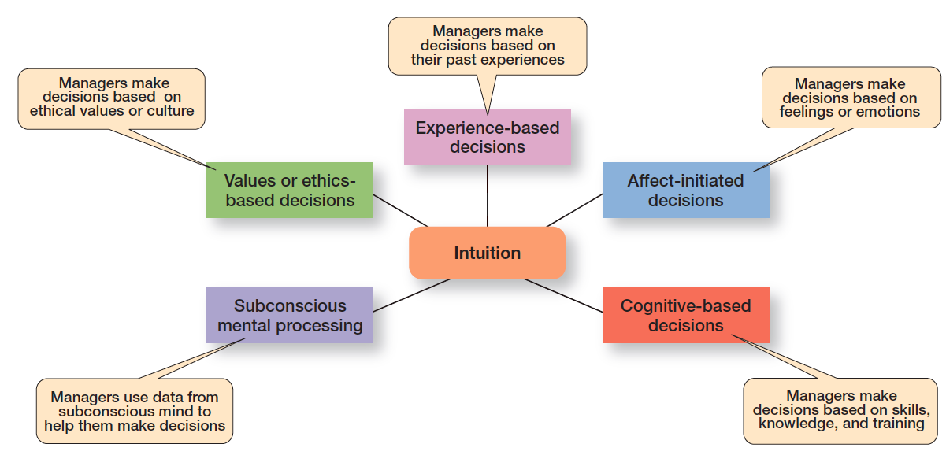
O que é a intuição?
Exhibit 2.6 shows the five different aspects of intuition identified by researchers studying managers’ use of intuitive decision making.
Notes:
Researchers studying managers’ use of intuitive decision making have identified five different aspects of intuition.
Source: Based on L. A. Burke and M. K. Miller, “Taking the Mystery Out of Intuitive Decision Making,” Academy of Management Executive, October 1999, pp. 91–99.

Slide 24
Modos de tomada de decisão: Baseada na evidência
Gestão baseada em Evidência (EBMgt)
Uso sistemático da melhor evidência para melhorar a prática da gestão.
Notes:
“Any decision-making process is likely to be enhanced through the use of relevant and reliable evidence, whether it’s buying someone a birthday present or wondering which new washing machine to buy.” That’s the premise behind evidence-based management (EBMgt), the “systematic use of the best available evidence to improve management practice.
EBMgt is quite relevant to managerial decision-making. The four essential elements of EBMgt are the decision maker’s expertise and judgment; external evidence that’s been evaluated by the decision maker; opinions, preferences, and values of those who have a stake in the decision; and relevant organizational (internal) factors such as context, circumstances, and organizational members.

Slide 25
Crowdsourcing
Crowdsourcing: uma abordagem ao processo de tomada de tomada de decisão em que se solicitam ideias e contribuições a uma rede de pessoas, fora do tradicional conjunto de decisores.
Exemplos: clientes, fornecedores, publico em geral.
Alguns exemplos dos dias de hoje
https://digiday.com/marketing/5-brands-winning-at-crowdsourcing/
Notes:
Crowdsourcing involves soliciting ideas from the internet so you can learn from the collective insights of a diverse group of people. Discuss the Hershey Co. example of a contest with a cash prize that helped the firm find a solution to shipping candy in warmer climates or summer months.

Slide 26
Tipos de decisões: problemas estruturados e decisões programadas
Problemas Estruturados
Imediatos/simples, familiares e facilmente definidos.
Decisões Programadas
Uma decisão repetida que pode ser tomada com base numa rotina.
Notes:
Some problems are straightforward. The decision maker’s goal is clear, the problem is familiar, and information about the problem is easily defined and complete. Such situations are called structured problems because they’re straightforward, familiar, and easily defined. Because it’s not an unusual occurrence, there’s probably some standardized routine for handling it. This is what we call a programmed decision, a
repetitive decision that can be handled by a routine approach. Because the problem is structured, the manager doesn’t have to go to the trouble and expense of going through an involved decision process. The “develop-the-alternatives” stage of the decision-making process either doesn’t exist or is given little attention. Why? Because once the structured problem is defined, the solution is usually self-evident or at least reduced to a few alternatives that are familiar and have proved successful in the past.

Slide 27
Tipos de decisões programadas
Procedimento - uma série de passos sequenciais usados para responder a problemas estruturados.
Regra – uma informação (normalmente escrita) que diz aos gestores o que se pode ou não pode fazer.
Política – orientação genérica criada para condicionar o processo de tomada de decisão.
Notes:
A procedure is a series of sequential steps a manager uses to respond to a structured problem. The only difficulty is identifying the problem. Once it’s clear, so is the procedure. For instance, a purchasing manager receives a request from a warehouse manager for 15 tablets for the inventory clerks.
A rule is an explicit statement that tells a manager what can or cannot be done. Rules are frequently used because they’re simple to follow and ensure consistency. For example, rules about lateness and absenteeism permit supervisors to make disciplinary decisions rapidly and fairly.
The third type of programmed decisions is a policy, a guideline for making a decision. In contrast to a rule, a policy establishes general parameters for the decision maker rather than specifically stating what should or should not be done. Policies typically contain an ambiguous term that leaves interpretation up to the decision maker.

Slide 28
Tipos de decisões: problemas não estruturados e decisões não programadas
Problemas não Estruturados – problemas novos (ou não usuais) e para os quais a informação é ambígua ou incompleta.
Decisões não Programadas - não recorrentes e que envolvem soluções específicas e únicas.
Notes:
Not all the problems managers face can be solved using programmed decisions. Many organizational situations involve unstructured problems, new or unusual problems for which information is ambiguous or incomplete. Whether to build a new manufacturing facility in China is an example of an unstructured problem.

Slide 29
Decisões programadas vs.
Decisões não programadas
Characteristic | Programmed Decisions | Nonprogrammed Decisions
Type of problem | Structured | Unstructured
Managerial level | Lower levels | Upper levels
Frequency | Repetitive, routine | New, unusual
Information | Readily available | Ambiguous or incomplete
Goals | Clear, specific | Vague
Time frame for solution | Short | Relatively long
Solution relies on… | Procedures, rules, policies | Judgment and creativity
Notes:
Exhibit 2-7 describes the differences between programmed and nonprogrammed decisions. Lower-level managers mostly rely on programmed decisions (procedures, rules, and policies) because they confront familiar and repetitive problems. As managers move up the organizational hierarchy, the problems they confront become more unstructured.

Slide 30
Estilos de Tomada de Decisão
Investigadores identificaram quatro diferentes estilos de tomada de decisão individual, baseado em duas dimensões:
  Na forma de pensar do indivíduo
  Na tolerância da ambiguidade do indivíduo
Os quatro estilos são:
Diretivo
Analítico
Conceptual
Comportamental
Notes:
Way of thinking: People that approach decisions from a rational perspective will logically process information and to make sure it’s logical and consistent before making a decision. Others tend to be more creative and intuitive.
Tolerance for ambiguity: Some of us have a low tolerance for ambiguity and prefer order and certainty. Others can tolerate much higher levels of uncertainty and can process numerous thoughts at the same time.
When you diagram these two dimensions you get four possible decision-making styles.

Slide 31
Os Quatro Estilos de Tomada de Decisão
Estilo diretivo: baixa tolerância à ambiguidade e busca a racionalidade.
Estilo analítico: busca a racionalidade, mas tem uma tolerância maior para a ambiguidade
Estilo conceptual: tomadores de decisão intuitivos com alta tolerância à ambiguidade
Estilo comportamental: tomadores de decisão intuitivos com baixa tolerância à ambiguidade
Notes:
Each of these different styles has different strengths and weaknesses. While these four styles are distinct, most managers will display characteristics from more than one style.

Slide 32
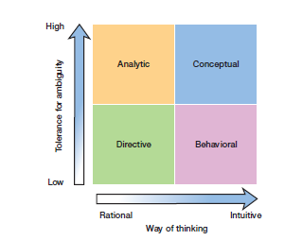
Os Quatro Estilos de Tomada de Decisão
Exhibit 2.8 shows the decision-style model from A. J. Rowe and J. D. Boulgarides, Managerial Decision Making (Upper Saddler River, N J: Prentice Hall, 1992), p. 29.
Notes:
Visual of the Decision-Style Model. Most business students will score highest on the analytical style.
Long Description:
The horizontal axis shows “Way of thinking” ranging from “Rational” on the left end to “Intuitive” on the right end. The vertical axis shows “Tolerance for ambiguity” from “Low” at the bottom end to “High” at the top end.
Four styles of decision-making are shown in the following intersecting regions:
Rational, Low tolerance for ambiguity: Directive
Rational, High tolerance for ambiguity: Analytic
Intuitive, Low tolerance for ambiguity: Behavioral
Intuitive, High tolerance for ambiguity: Conceptual

Slide 33
Condições /contexto do processo de decisão
Certeza – situação em que os resultados de todas as alternativas são conhecidos pelo decisor.
Risco – situação em que os o decisor consegue estimar a probabilidade (esperada/aproximada) de acontecimento dos resultados para todas as alternativas.
Incerteza - situação em que os o decisor não consegue estimar a probabilidade (esperada/aproximada) de acontecimento dos resultados para todas as alternativas.
Notes:
The ideal situation for making decisions is one of certainty, a situation where a manager can make accurate decisions because the outcome of every alternative is known. For example, when Wyoming’s state treasurer decides where to deposit excess state funds, he knows exactly the interest rate offered by each bank and the amount that will be earned on the funds. He is certain about the outcomes of each alternative. As you might expect, most managerial decisions aren’t like this.
A far more common situation is one of risk, conditions in which the decision maker is able to estimate the likelihood of certain outcomes. Under risk, managers have historical data from past personal experiences or secondary information that lets them assign probabilities to different alternatives.
What happens if you face a decision where you’re not certain about the outcomes and can’t even make reasonable probability estimates? We call this condition uncertainty. Managers face decision-making situations of uncertainty. Under these conditions, the choice of alternative is influenced by the limited amount of available information and by the psychological orientation of the decision maker.

Slide 34
Gestão do Risco
Os gestores podem utilizar informação disponível (ex: tendências do passado) para atribuir probabilidades a diferentes alternativas.
O objetivo é calcular o valor esperado – multiplicando o resultado esperado de cada alternativa pela probabilidade de ocorrência de cada alternativa.
Notes:
Under risk, managers have historical data from past personal experiences or secondary information that lets them assign probabilities to different alternatives.

Slide 35
Valor Esperado
Event | Expected Revenues | Probability | Expected Value of Each Alternative
Heavy snowfall | $850,000 | 0.3 | $255,000
Normal snowfall | $725,000 | 0.5 | $362,000
Light snowfall | $350,000 | 0.2 | $70,000
Blank | Blank | Total expected revenue: | $687,500
For each Event in the table, Expected Revenues multiplied by Probability gives the Expected Value of Each Alternative.
Notes:
Let’s try an example. Suppose you manage a Colorado ski resort, and you’re thinking about adding another lift. Obviously, your decision will be influenced by the additional revenue that the new lift would generate, which depends on snowfall. You have fairly reliable weather data from the last 10 years on snowfall levels in your area—three years of heavy snowfall, five years of normal snowfall, and two years of light snow. And you have good information on the amount of revenues generated during each level of snow.
You can use this information to help you make your decision by calculating expected value—the expected return from each possible outcome—by multiplying expected revenues by snowfall probabilities. The result is the average revenue you can expect over time if the given probabilities hold. As Exhibit 2-8 shows, the expected revenue from adding a new ski lift is $687,500. Of course, whether that’s enough to justify a decision to build depends on the costs involved in generating that revenue.

Slide 36
Matrix de Resultados
Visa Marketing Strategy (in millions of dollars | MasterCard CA 1 | MasterCard CA 2 | MasterCard CA 3
Strategy 1 | 13 | 14 | 11
Strategy 2 | 9 | 15 | 18
Strategy 3 | 24 | 21 | 15
Strategy 4 | 18 | 14 | 28
Exhibit 2-9 shows the various Visa strategies and the resulting profit, depending on the competitive action (CA) used by MasterCard.
Notes:
A marketing manager at Visa has determined four possible strategies (Strategy 1, Strategy 2, Strategy 3, and Strategy 4) for promoting the Visa card throughout the West Coast region of the United States. The marketing manager also knows that major competitor MasterCard has three competitive actions (CA 1, CA 2, and CA 3) it’s using to promote its card in the same region. For this example, we’ll assume that the Visa manager had no previous knowledge that would allow her to determine probabilities of success of any of the four strategies. She formulates the matrix shown in Exhibit 2-9 to show the various Visa strategies and the resulting profit, depending on the competitive action used by MasterCard.

Slide 37
Matriz de Arrependimento
Visa Marketing Strategy (in millions of dollars | MasterCard CA 1 | MasterCard CA 2 | MasterCard CA 3
Strategy 1 | 11 | 7 | 17
Strategy 2 | 15 | 6 | 10
Strategy 3 | 0 | 0 | 13
Strategy 4 | 6 | 7 | 0
Notes:
Managers calculate regret by subtracting all possible payoffs in each category from the maximum possible payoff for each given event, in this case for each competitive action. For our Visa manager, the highest payoff—given that MasterCard engages in CA1, CA2, or CA3—is $24 million, $21 million, or $28 million, respectively (the highest number in each column). Subtracting the payoffs in Exhibit 2-9 from those figures produces the results shown in Exhibit 2-10.

Slide 38
Heurísticas
Heurísticas são os processos utilizados pelos gestores para simplificar informação que é complexa, incerta, ou ambígua.
Estes processos podem levar a erros e enviesamentos no processo de tomada de decisão.
Notes:
When managers make decisions, they not only use their own particular style, they may use “rules of thumb,” or heuristics, to simplify their decision-making. Rules of thumb can be useful because they help make sense of complex, uncertain, and ambiguous information. Even though managers may use rules of thumb, that doesn’t mean those rules are reliable. Why? Because they may lead to errors and biases in processing and evaluating information.

Slide 39
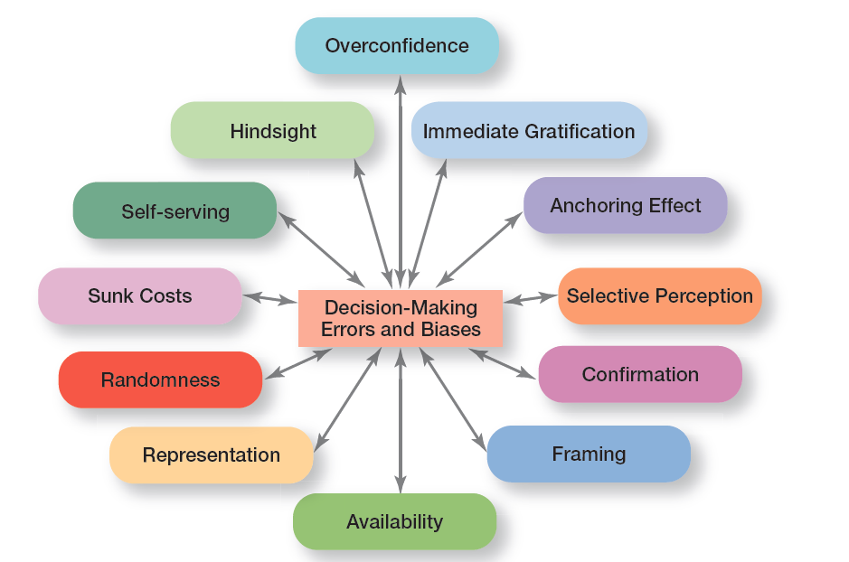
Erros e enviesamentos mais comuns no processo de decisão
Notes:
Exhibit 2-11 identifies 12 common decision errors of managers and biases they may have. Let’s look at each.

Slide 40
Erros e Enviesamentos mais comuns (1 of 4)
Viés do Excesso de confiança (Overconfidence Bias): deter expectativas irrealisticamente positivas sobre nós próprios e/ou sobre a nossa performance).
Viés da Gratificação imediata (Immediate Gratification Bias): escolher alternativas que oferecem recompensas imediatas e evitem custos imediatos.
Viés do Efeito âncora (Anchoring Effect): fixação nas informações iniciais, ignorando as informações subsequentes.
Notes:
When decision makers tend to think they know more than they do or hold unrealistically positive views of themselves and their performance, they’re exhibiting the overconfidence bias.
The immediate gratification bias describes decision makers who tend to want immediate rewards and to avoid immediate costs. For these individuals, decision choices that provide quick payoffs are more appealing than those with payoffs in the future.
The anchoring effect describes how decision makers fixate on initial information as a starting point and then, once set, fail to adequately adjust for subsequent information. First impressions, ideas, prices, and estimates carry unwarranted weight relative to information received later.

Slide 41
Erros e Enviesamentos mais comuns (2 of 4)
Viés da Perceção seletiva (Selective Perception Bias): selecionar, organizar e interpretar eventos com base nas percepções tendenciosas do decisor.
Viés da Confirmação (Confirmation Bias): procurar informações que reafirmem as escolhas anteriores, enquanto desconta informações contraditórias.
Viés de Enquadramento (Framing Bias): selecionar e destacar certos aspectos de uma situação, com base numa perspetiva, enquanto ignora outros aspectos porque obrigam a ver a situação sob um ângulo alternativo.
Notes:
When decision makers selectively organize and interpret events based on their biased perceptions, they’re using the selective perception bias. This influences the information they pay attention to, the problems they identify, and the alternatives they develop.
Decision makers who seek out information that reaffirms their past choices and discount information that contradicts past judgments exhibit the confirmation bias.
The framing bias is when decision makers select and highlight certain aspects of a situation while excluding others. By drawing attention to specific aspects of a situation and highlighting them, while at the same time downplaying or omitting other aspects, they distort what they see and create incorrect reference points.

Slide 42
Erros e Enviesamentos mais comuns (3 of 4)
Viés da Disponibilidade (Availability Bias): perder a objetividade da decisão ao se concentrar nos eventos mais recentes.
Viés da Representação (Representation Bias): fazer analogias e ver situações idênticas, quando não existem.
Viés da Aleatoriedade (Randomness Bias): criando significado infundado a partir de eventos aleatórios.
Notes:
The availability bias happens when decision makers tend to remember events that are the most recent and vivid in their memory. The result? It distorts their ability to recall events in an objective manner and results in distorted judgments and probability estimates.
When decision makers assess the likelihood of an event based on how closely it resembles other events or sets of events, that’s the representation bias. Managers exhibiting this bias draw analogies and see identical situations where they don’t exist.
The randomness bias describes the actions of decision makers who try to create meaning out of random events. They do this because most decision makers have difficulty dealing with chance even though random events happen to everyone, and there’s nothing that can be done to predict them.

Slide 43
Erros e Enviesamentos mais comuns (4 of 4)
Erro dos custos afundados (Sunk Costs Errors): esquecer que as ações atuais devem ter em conta apenas as consequências futuras e não o que já aconteceu no passado.
Viés da autoconveniência (Self-serving Bias): receber rapidamente crédito pelos sucessos e culpar os fatores externos pelos fracassos.
Viés retrospectivo (Hindsight Bias): acreditar, erradamente, que um evento poderia ter sido previsto dado o conhecimento posterior do resultado. Ex: “Eu sabia!” “Era óbvio!”
Notes:
The sunk costs error occurs when decision makers forget that current choices can’t correct the past. They incorrectly fixate on past expenditures of time, money, or effort in assessing choices rather than on future consequences. Instead of ignoring sunk costs, they can’t forget them.
Decision makers who are quick to take credit for their successes and to blame failure on outside factors are exhibiting the self-serving bias.
Finally, the hindsight bias is the tendency for decision makers to falsely believe that they would have accurately predicted the outcome of an event once that outcome is actually known.

Slide 44
Linhas orientadoras para um processo de tomada de decisão eficaz
Perceber as diferenças culturais.
Criar critérios de referência para um bom processo de tomada de decisão.
Saber quando é a altura de parar e desistir de uma solução/decisão.
Usar um processo de tomada de decisão que seja eficiente e eficaz.
Construir uma organização atenta ao inesperado e capaz de rapidamente se adaptar à mudança.
Notes:
Decision-making is serious business. Your abilities and track record as an effective decision maker will determine how your organizational work performance is evaluated and whether you’ll be promoted to higher and higher positions of responsibility. Below are some guidelines to help you be a better decision maker.
Understand cultural differences. Managers everywhere want to make good decisions. However, is there only one “best” way worldwide to make decisions? Or does the “best way depend on the values, beliefs, attitudes, and behavioral patterns of the people involved?”
Create standards for good decision making. Good decisions are forward-looking, use available information, consider all available and viable options, and do not create conflicts of interest.
Know when it’s time to call it quits. When it’s evident that a decision isn’t working, don’t be afraid to pull the plug.
Use an effective decision-making process.
Build an organization that can spot the unexpected and quickly adapt to the changed environment.

Slide 45
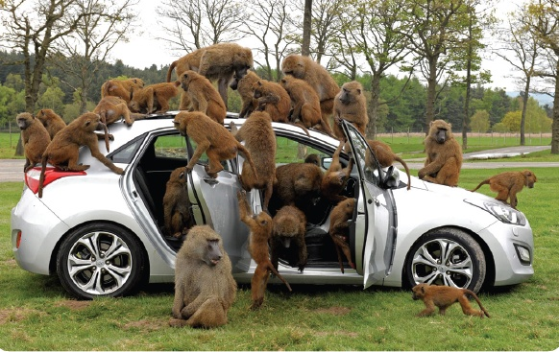
Design thinking e o processo de tomada de decisão
Design thinking
Abordar os problemas de gestão como os designers abordam os problemas de design.
2 - 45
Notes:
The way managers approach decision-making—using a rational and analytical mindset in identifying problems, coming up with alternatives, evaluating alternatives, and choosing one of those alternatives—may not be best and certainly not the only choice in today’s environment. That’s where design thinking comes in. Design thinking has been described as “approaching management problems as designers approach design problems.”
What can the design thinking approach teach managers about making better decisions? Well, it begins with the first step of identifying problems. Design thinking says that managers should look at problem identification collaboratively and integratively, with the goal of gaining a deep understanding of the situation. They should look not only at the rational aspects, but also at the emotional elements. Then invariably, of course, design thinking would influence how managers identify and evaluate alternatives. “A traditional manager (educated in a business school, of course) would take the options that have been presented and analyze them based on deductive reasoning and then select the one with the highest net present value. However, using design thinking, a manager would say, ‘What is something completely new that would be lovely if it existed but doesn’t now?’ ”
Design thinking means opening up your perspective and gaining insights by using observation and inquiry skills and not relying simply on rational analysis.

Slide 46
Big Data e o processo de tomada de decisão
Big data: volume elevado de dados quantificados que podem ser recolhidos e analisados por processos sofisticados de gestão de dados.
Pode ser uma ferramenta poderosa de tomada de decisão, mas recolher e analisar dados só para os ter é um desperdício de esforço.
Notes:
So what is big data? It’s the vast amount of quantifiable information that can be analyzed by highly sophisticated data processing. One IT expert described big data with “3V’s: high volume, high velocity, and/or high variety information assets.”
What does big data have to do with decision making? A lot, as you can imagine. With this type of data at hand, decision makers have very powerful tools to help them make decisions. However, experts caution that collecting and analyzing data for data’s sake is wasted e ort. Goals are needed when collecting and using this type of information. As one individual said, “Big data is a descendant of Taylor’s ‘scientific management’ of more than a century ago.”
While Taylor used a stopwatch to time and monitor a worker’s every movement, big data is using math modeling, predictive algorithms, and artificial intelligence software to measure and monitor people and machines like never before. But managers need to really examine and evaluate how big data might contribute to their decision making before jumping in with both feet. Why? Because big data, no matter how comprehensive or well analyzed, needs to be tempered by good judgment. For instance, a recent government report states: “Companies should remember that while big data is very good at detecting correlations, it does not explain which correlations are meaningful.”

Slide 47
Inteligência Artificial e Machine Learning
Inteligência Artificial (IA) – usa a capacidade de processamento dos computadores para resolver problemas complexos
  Os sistemas de IA têm a capacidade de aprender e tem permitido o uso de novas ferramentas para a tomada de decisão:
    Machine learning
    Deep learning
    Analytics
Notes:
Big data availability has paved the way for AI to expand data analysis and gives us new tools to help with decision making. These tools are machine learning, deep learning, and analytics.
Machine learning – Capacidade de aprender e melhorar com a experiência sem serem programados diretamente para a melhoria específica.
Deep learning – Sub ramo do ML, que procura nos dados modelos de vários níveis para hierarquicamente ir decidindo de forma mais eficiente e eficaz.
Analytics - A análise de gestão que se concentra na compreensão do desempenho dos negócios com base em dados e métodos estatísticos, com o objetivo de o melhorar.

Slide 48
Machine Learning, Deep Learning, e Analytics
Machine Learning (ML): um método de análise de dados que automatiza a construção de modelos analíticos.
Deep Learning: um subconjunto do ML que usa algoritmos para criar um nível hierárquico de redes neuronais artificiais que simulam a função do cérebro humano.
Analytics: o uso de matemática, estatística, modelação preditiva e ML para encontrar padrões significativos em um conjunto de dados.
Notes:
Overall, almost 100% of large corporations use some form of AI.

Slide 49
Questão 03:
(Responda p.f. através do Ms Teams)
Qual dos Quatro Estilos de Tomada de Decisão mais se aproxima do seu?
1. Diretivo
2. Analítico
3. Conceptual
4. Comportamental

Slide 50
The End

